Slide 1

DEPI
AMIT LEARNING
React Web Development
Udemy Project
The Udemy platform
aims to enhance access to education by offering a variety of courses in different fields, enabling students to learn new skills and achieve their academic and professional goals.
Ahmed Aboulnaga

Slide 2





our Team
Abdallah Salah
Yousef Hassan
Khaled Rabie
John Ayman
Ziad Elbanna

Slide 3

Introduction
In the age of modern technology, e-learning has become one of the most effective and flexible ways to learn. It allows learners to access a wide range of educational courses from anywhere, at any time. Therefore, we present to you our project: an online course platform, which aims to provide students and teachers with a rich and easy-to-use learning environment . This platform is designed to meet the needs of learners, where they can find a variety of courses that suit their interests and skills. Through this platform, teachers will be able to easily create and manage their own courses, making it easier for them to share their knowledge and experience with students.......

Slide 4

PROJECT OUTLINE
1. Project Overview
2. Objectives
3. Technology Stack:
Frontend
Backend
4. Features
5.Development Phases

Slide 5

Project Overview
An online educational platform where users can browse, enroll, and participate in courses. Admins can create and manage the courses, while students can track their learning progress, leave feedback, and interact with course materials.

Slide 6


Objectives
Provide a user-friendly platform for online learning.
Allow Admins to create and manage courses.
Enable students to browse courses, enroll, and track progress.
Integrate a rating and review system for courses.

Slide 7
Technology Stack
1.Frontend:
React: For building the user interface and handling state with components.
Context API: For managing global state across the application.
React Router: For navigation between different pages.
Axios/Fetch API: For making HTTP requests to the backend.
Material-UI/Bootstrap: For styling and pre-designed UI components.
2.Backend:
Node.js & Express: For creating a RESTful API.
MongoDB : For storing user data, courses, and reviews.
Mongoose : For object data modeling (ODM).
Dotenv: For loading environment variables from .env

Slide 8
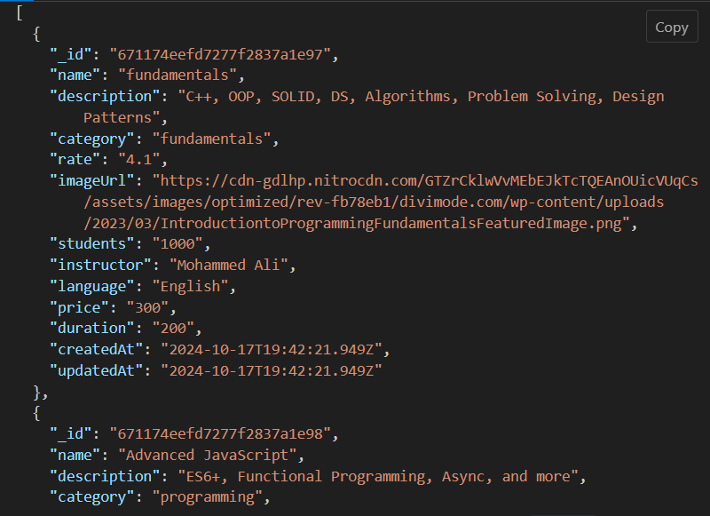
Features
1.Backend (Express)
RESTful API Endpoints
/api/courses/
GET all courses or by specific filters.

Slide 9
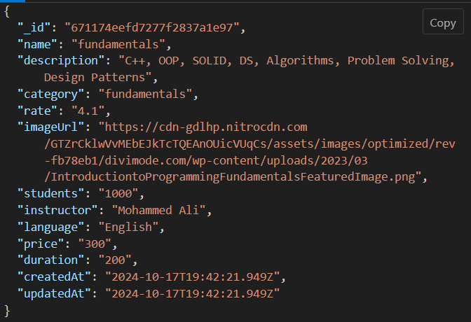
Features
1.Backend (Express)
RESTful API Endpoints
/api/courses/:id
Get : (get specifice course).
Response:

Slide 10
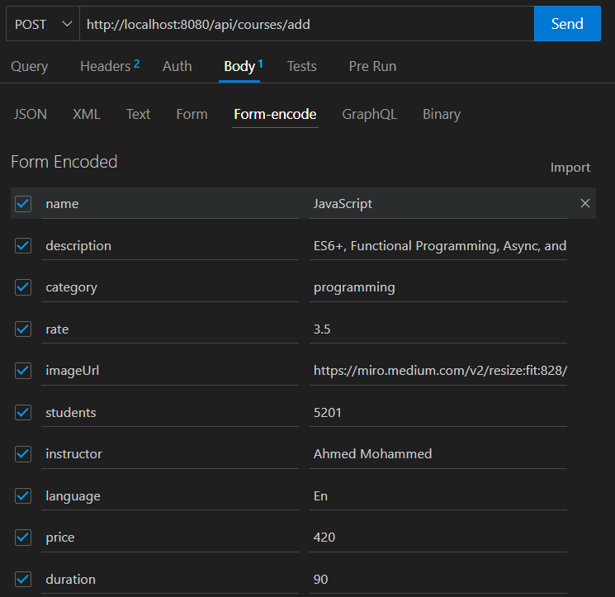
Features
1.Backend (Express)
RESTful API Endpoints
/api/courses/add
POST (Admin only) to create a new course. .
Response:

Slide 11
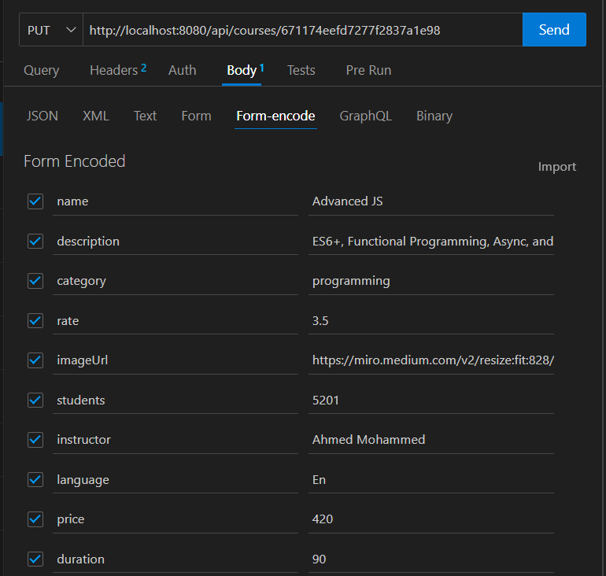
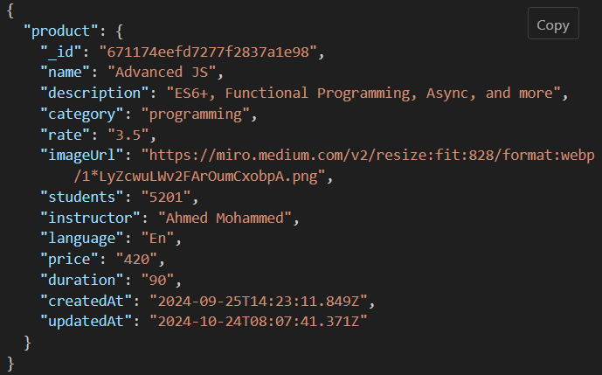
Features
1.Backend (Express)
RESTful API Endpoints
/api/courses/:id
PUT (Admin only) to update coursedetails.
Response:

Slide 12
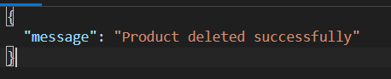
Features
1.Backend (Express)
RESTful API Endpoints
/api/courses/delete/:id
DELETE(Admin only) to update coursedetails.
Response:

Slide 13
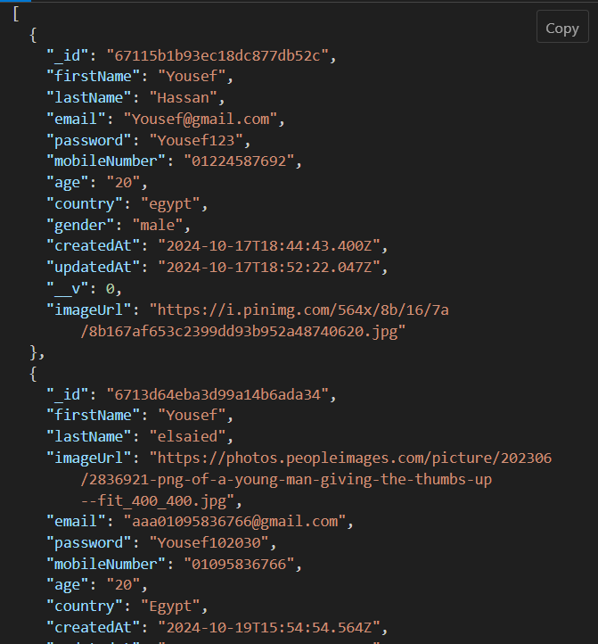
Features
1.Backend (Express)
RESTful API Endpoints
/api/users/
GET all users or by specific filters.

Slide 14
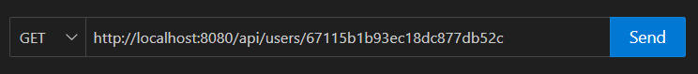
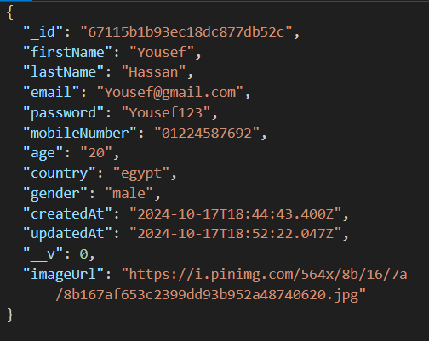
Features
1.Backend (Express)
RESTful API Endpoints
/api/users/:id
Get : (get specifice user).
Response:

Slide 15
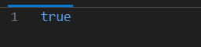
Features
1.Backend (Express)
RESTful API Endpoints
/api/users/:id
Get : (get specifice user by email).
Response:

Slide 16
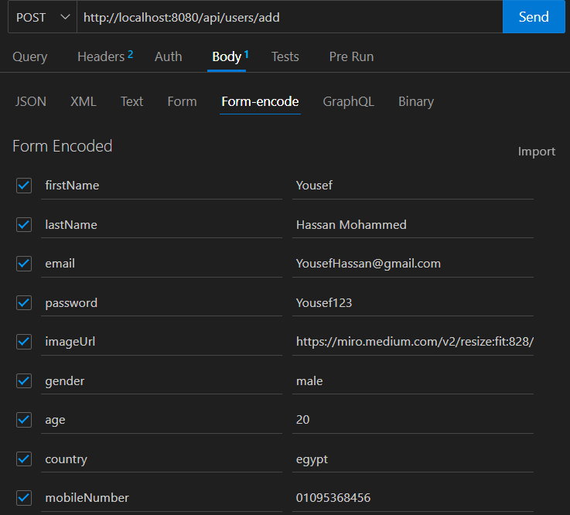
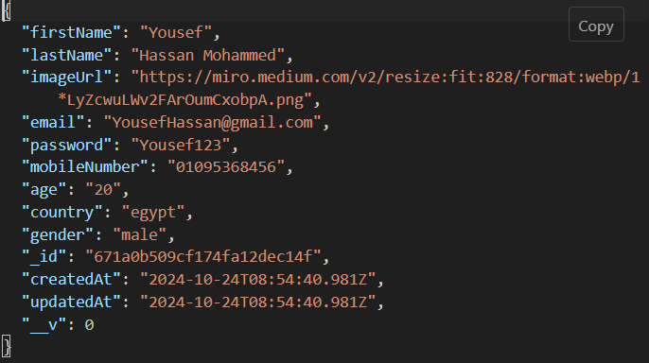
Features
1.Backend (Express)
RESTful API Endpoints
/api/users/add
POST for add new user to the system. .
Response:

Slide 17
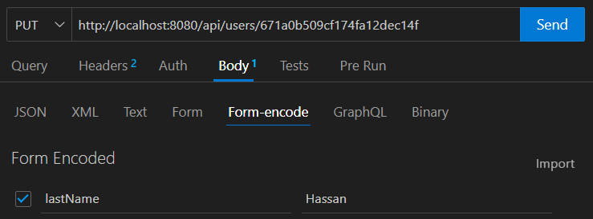
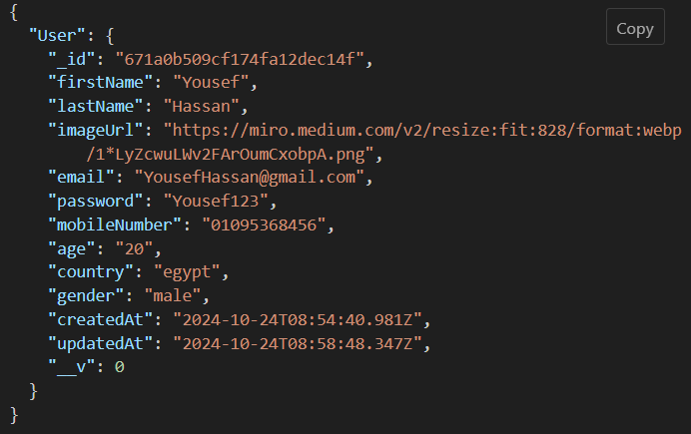
Features
1.Backend (Express)
RESTful API Endpoints
/api/users/:id
PUT to update user.
Response:

Slide 18
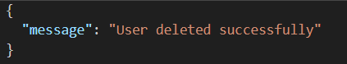
Features
1.Backend (Express)
RESTful API Endpoints
/api/users/delete/:id
DELETE to delete specific user.
Response:

Slide 19
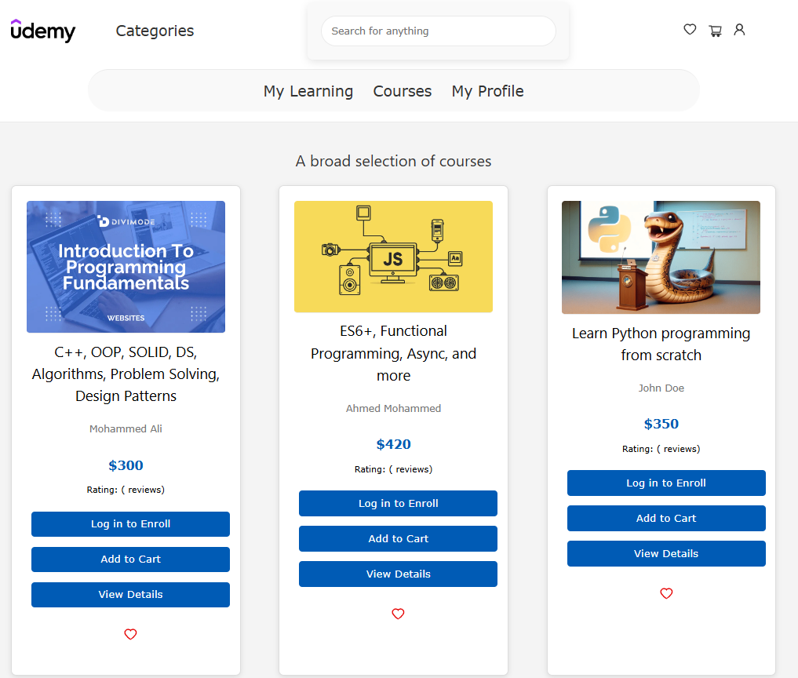
Features
2.Frontend (React):
Homepage
Display featured courses.
Enroll , add to cart , favourite courses.
Show my learning courses

Slide 20
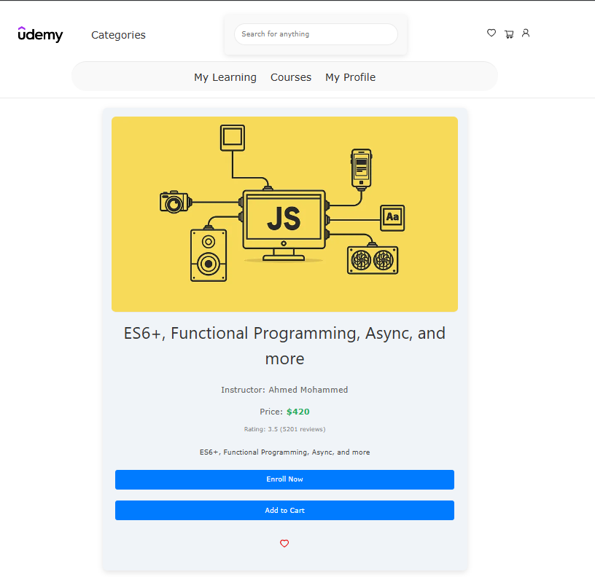
Features
2.Frontend (React):
Course Detail Page
Course title, description, instructor details, price, and rating.
"Enroll" button for students.
Rating and review section.

Slide 21
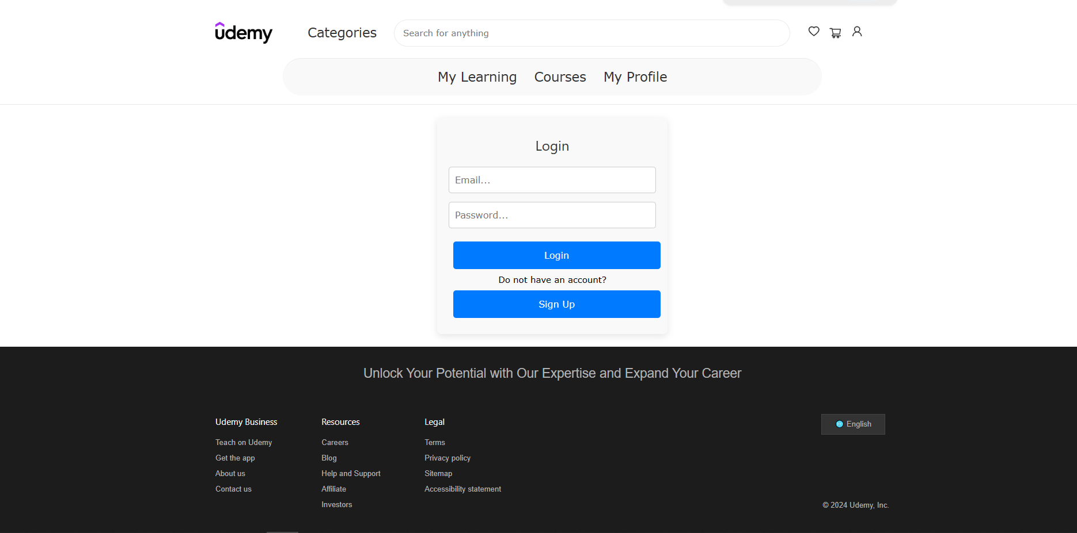
Features
2.Frontend (React):
Login & Signup Pages
Enable User to Login if he has an account to interact with the app
Purpose: Create and authenticate users.
Key Actions:
- Login or Sign Up.
- Store user data in the database.

Slide 22
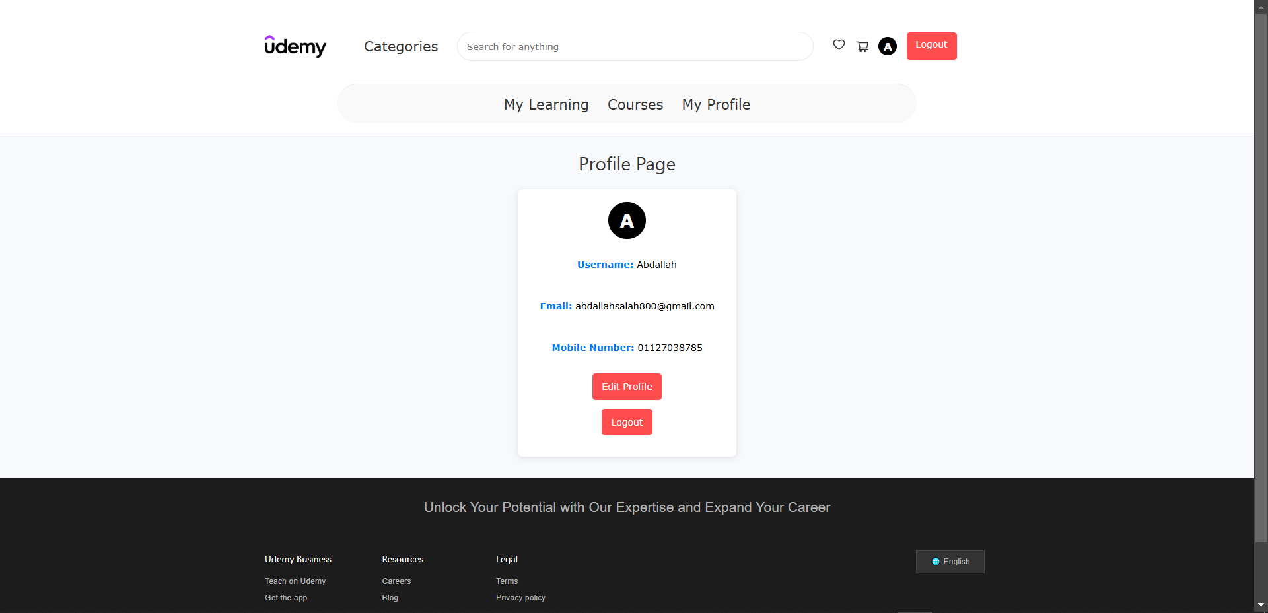
Features
2.Frontend (React):
Course Detail Page
Purpose: Display user-specific details, including personal information and course history.
Key Elements:
User Information: Display username, email, and other profile details.
Learning History: List of all courses completed by the user.
Profile Edit Options: Ability to update personal information or change the password.

Slide 23
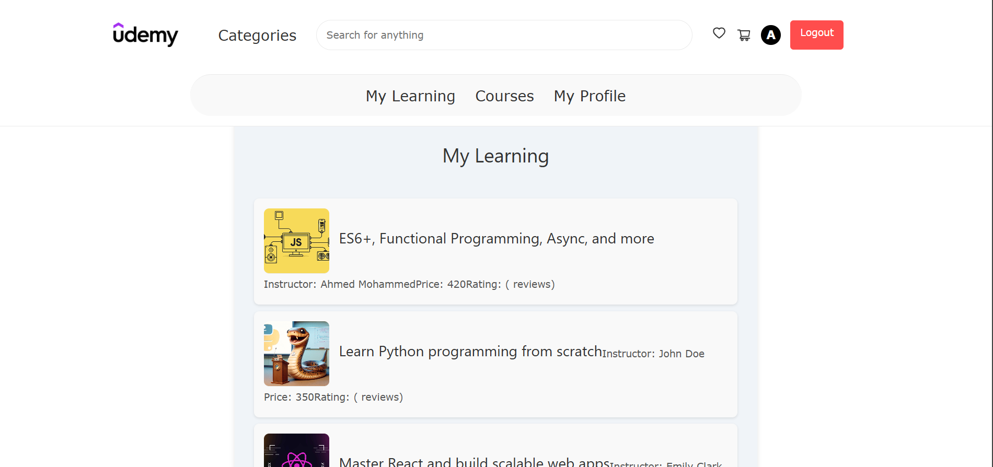
Features
2.Frontend (React):
My Learning Page =
Purpose: Displays the courses that the user has enrolled in
Key Elements:
List of Enrolled Courses: Shows all active courses the user is learning.

Slide 24
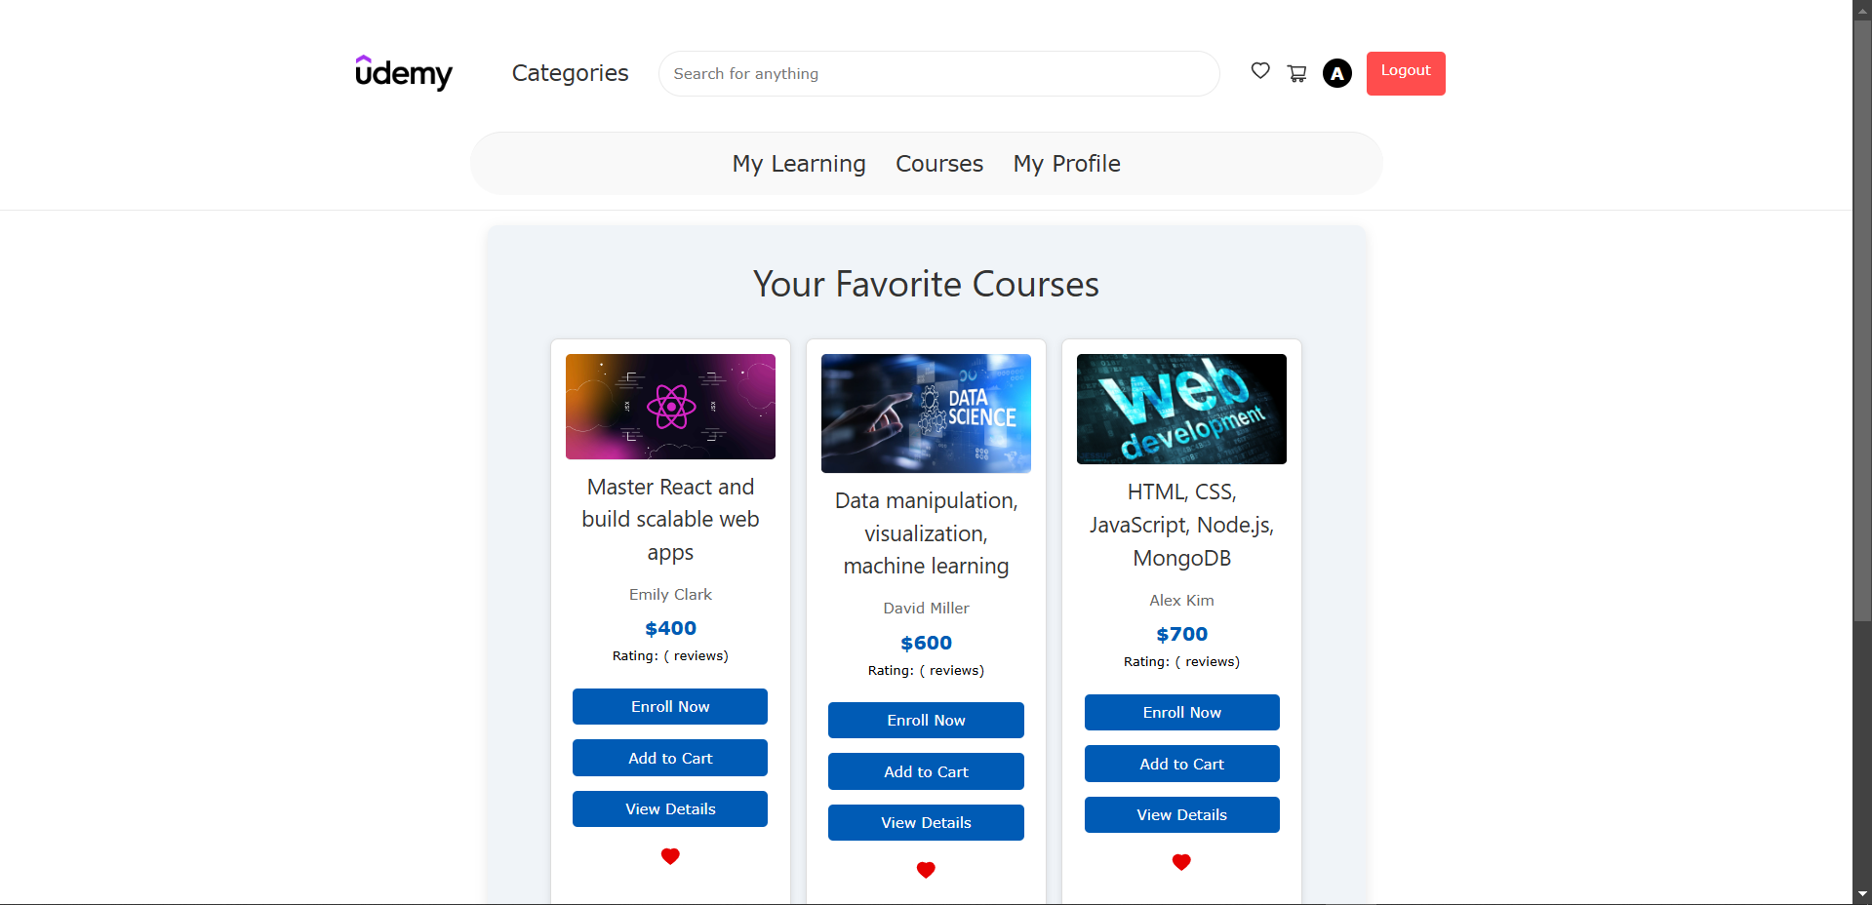
Features
2.Frontend (React):
Favorite page
Purpose: Displays the courses that the user has added to favorite
Key Elements:
List of Enrolled Courses: Shows all active courses the user is added to favorite page.

Slide 25
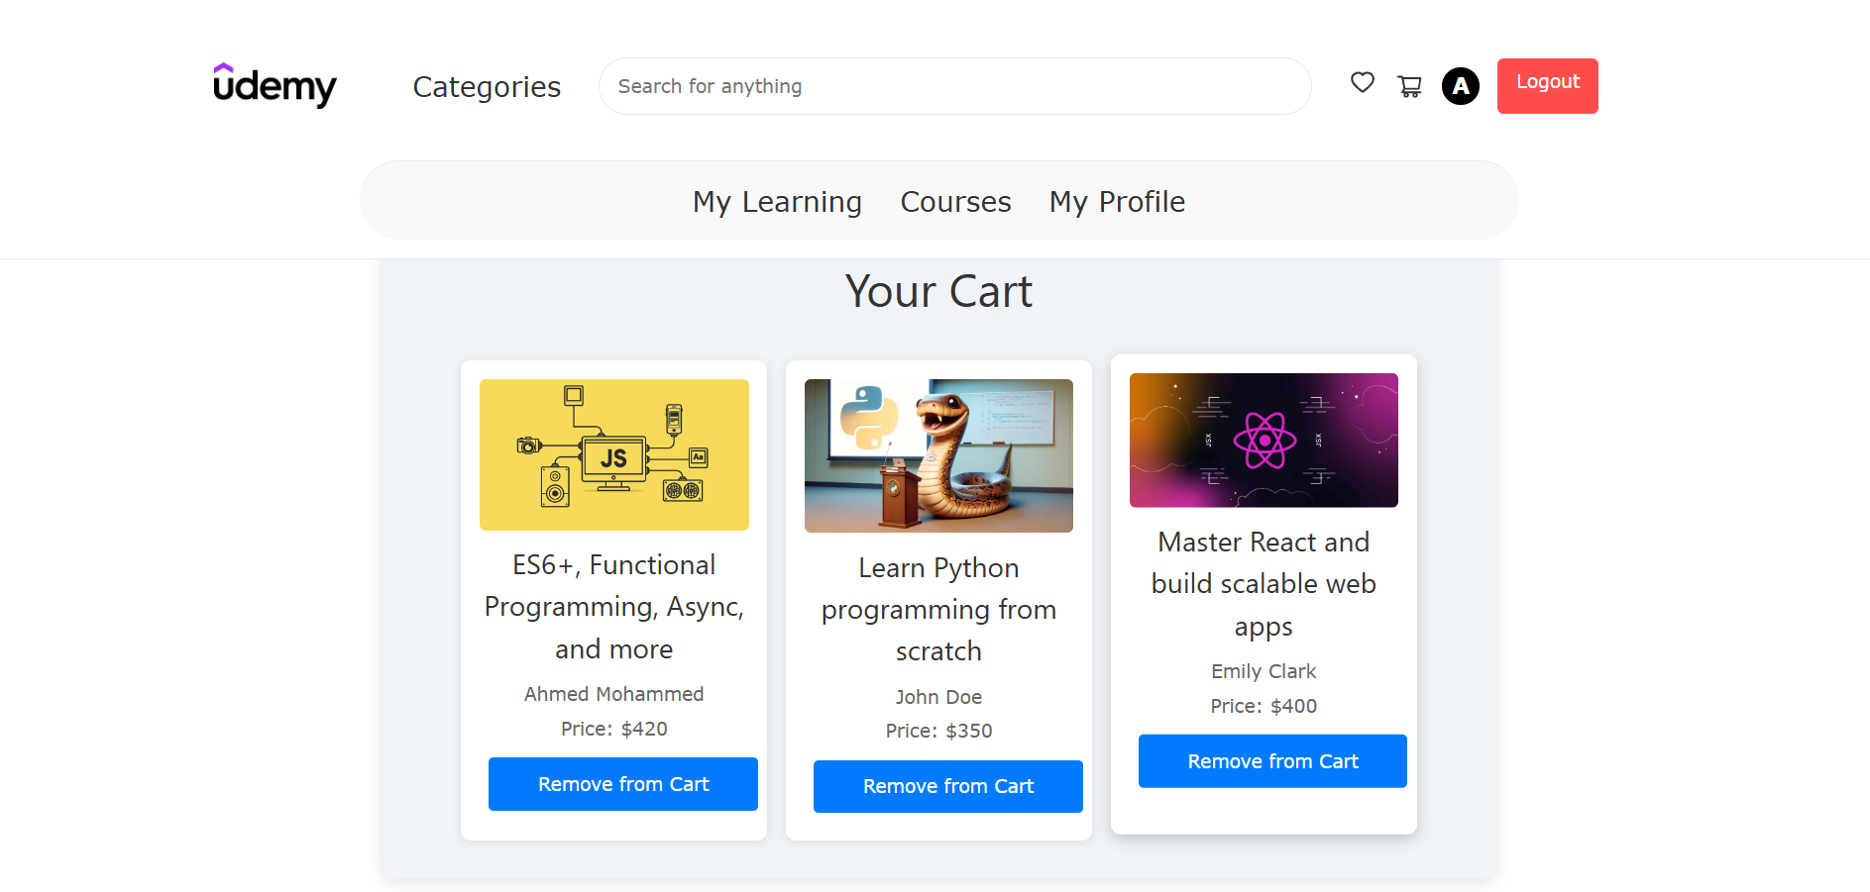
Features
2.Frontend (React):
Course Card Page
Purpose: Displays the courses that the user has added to the card
Key Elements:
List of Enrolled Courses: Shows all active courses the user is added to card.

Slide 26
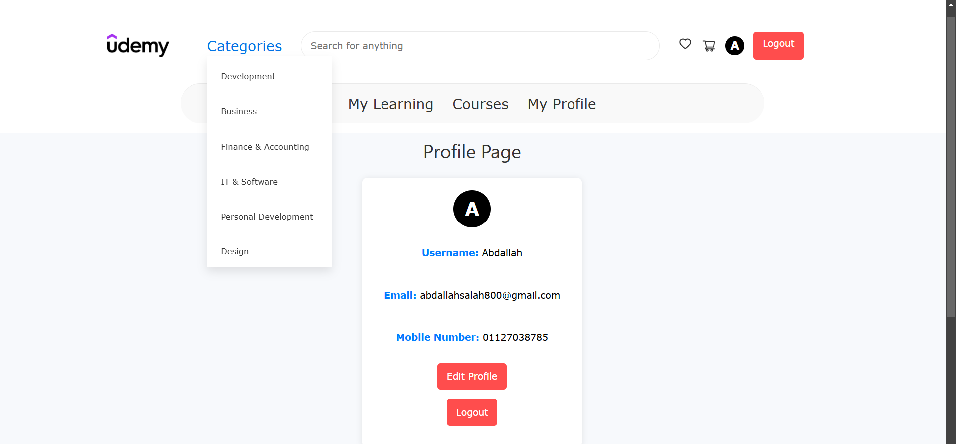
Features
2.Frontend (React):
Categories Menu
Enable User to navigate to additional pages

Slide 27
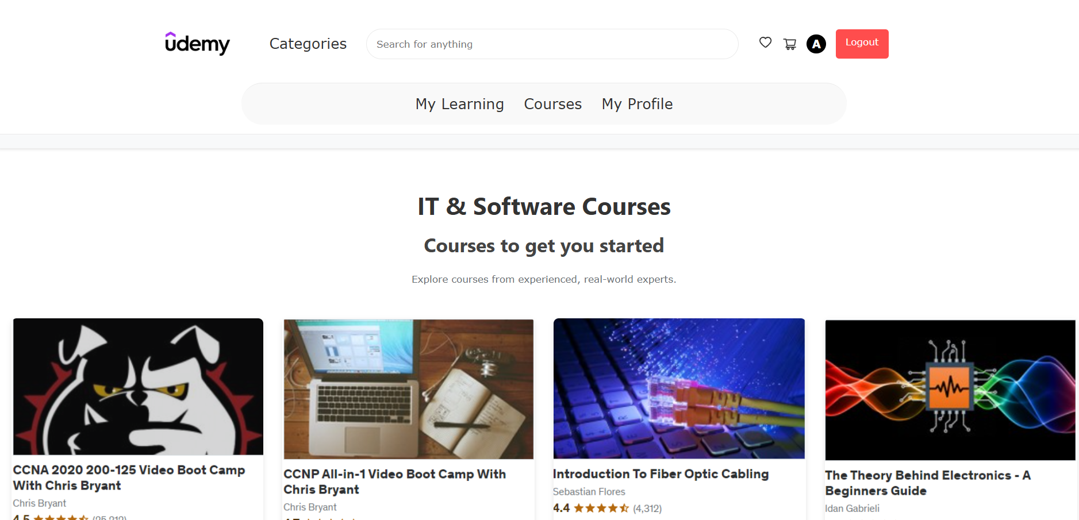
Features
2.Frontend (React):
Additional pages
The pages in categories menu

Slide 28
Thank You

